Slide 1
AIRCRAFT ACCIDENTS
ARAN BEN EZRA & SHAY SOLOMON

Slide 2
INTRODUCTION
Aviation is a fascinating world, that has rapidly developed since the first motor-operated aircraft was flown by the Wright brothers in 1903.
Humanity gained the almost impossible power – to fly.
However, with this ‘superpower’ – risks have arisen.
With time and development of the aviation sector, more aircrafts with more people – are sent to the skies.
With such powerful, heavy aircrafts that fly in high speed and reach high altitudes, accidents are sure to occur.

Slide 3
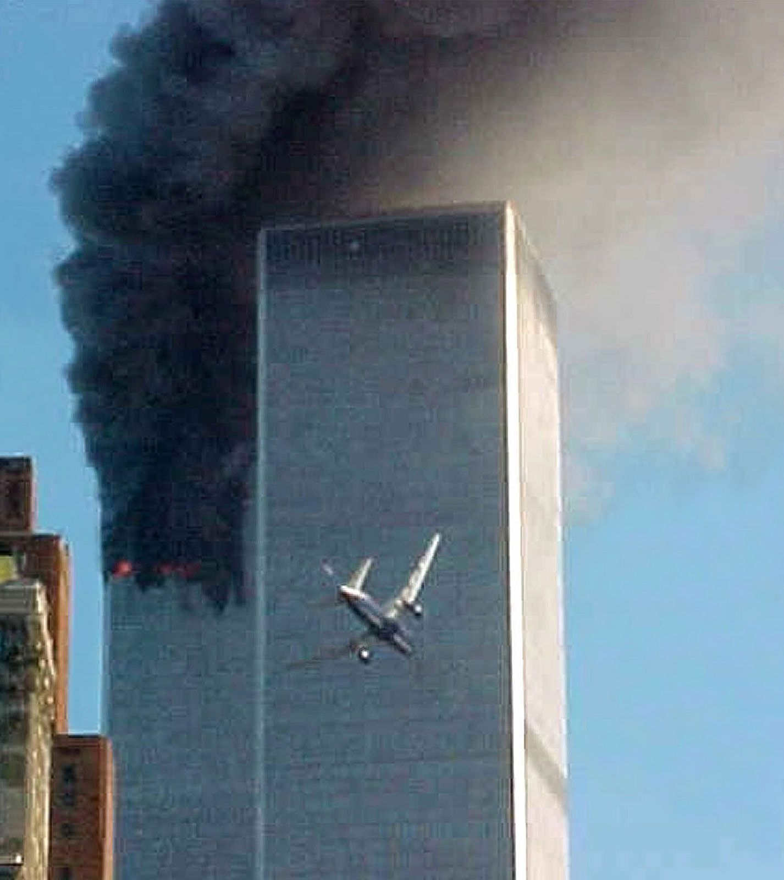
Time and fate have already told the sad story.
The higher the number of aircrafts and passengers – the higher the risk for an accident, which carries a risk for fatalities.
While chances are low, we wanted to understand:
Do several factors about the flight, the aircraft, and flight location – can help us to predict whether there, and how many fatalities will be in a case of an accident?
A Boeing-767 aircraft crashes into the World Trade Center, killing its 65 occupants, 11 SEPTEMBER 2001

Slide 4
MAIN STEPS
DATA CLEANING & HANDLING
01
02
DATA ACQUISITION
03
04
VISUAL DATA ANALYSIS
MACHINE LEARNING

Slide 5
01
DATA ACQUISITION

Slide 6
DATA ACQUISITION
SUB-STEP 1
SUB-STEP 2
SUB-STEP 3
We used the BeautifulSoup to acquire our data
By crawling and scraping the data from the website of AviationSafetyNetwork that contained raw data about every accident
That has occurred between 1920-2021.
As every accident has appeared in a separate URL, we scarped all URLs and built a list of them
To overcome possible lack of data in the next step, we scraped for an Aircraft-Engine dictionary file
Using previous steps outcomes, we started accessing each accident page, and built the data frame

Slide 7
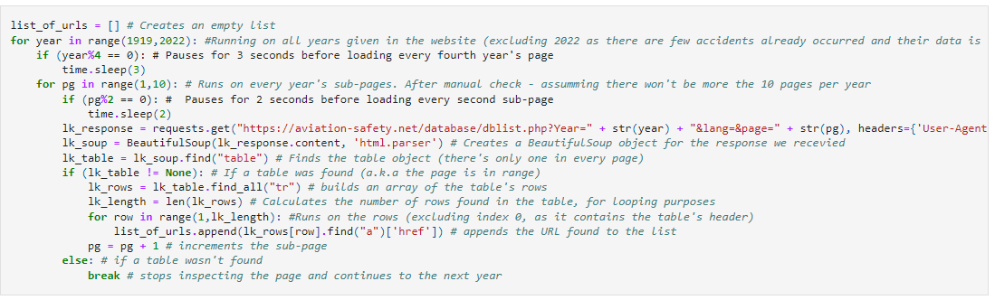
SUB-STEP 1 – SCRAPING URLS
All accidents could be accessed from the website accidents database page.
There, they were divided by the year they occurred, and every year had several pages containing links to the accidents. The pages that display the links, have a very similar URL template, with reference to the year and the page number. Therefore we could use a nested loop for easy access:
The step’s output: The ‘accidents_urls.txt’ file

Slide 8
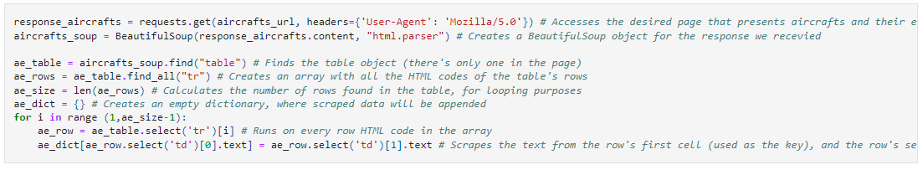
SUB-STEP 2 – AIRCRAFT-ENGINE DICTIONARY
We understood that there are many individual types of aircrafts. As we wanted to reduce them we also found out that some pages miss some values about the aircraft that can be referred explicitly by the aircraft type. So we decided to access the general aircraft information pages of the website, and to build a dictionary that matches between the aircraft model to the engine type it can own.
The step’s output: The ‘aircrafts_to_engines.txt’ file

Slide 9
SUB-STEP 3 – BUILDING DATA FRAME
This step is the most complicated.
There is a use for both files we created in the previous sub-steps.
We created lists to represent the columns in the data frame –to-be. Then, we accessed every link we scraped in SUB-STEP 1 and looked for two segments of each page, which include vital and necessary data for our data frame.
01
02
A TABLE
EXTERNAL WEB OBJECT
Includes the raw data, with what the data is and the value in text and numbers.
Which includes an interactive map script

Slide 10
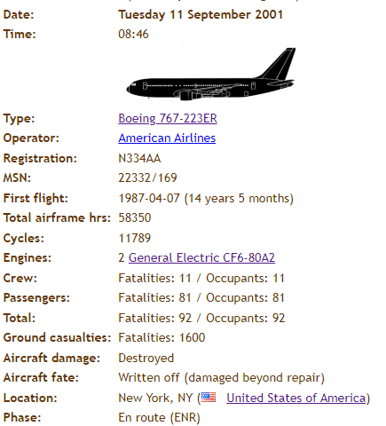
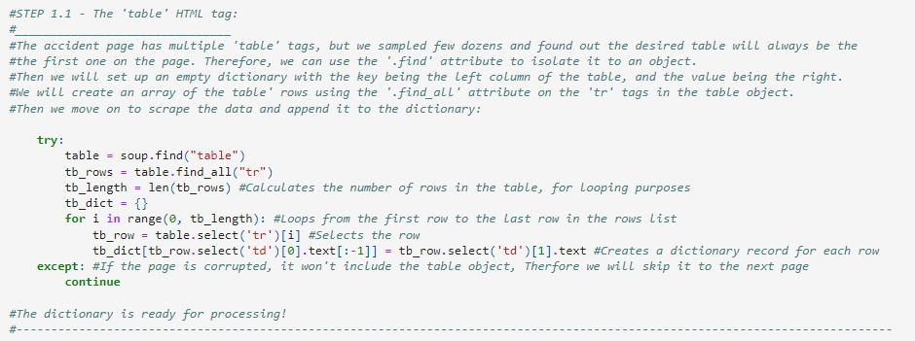
SUB-STEP 3.1 – ACCESSING THE TABLE
With BeautifulSoup we accessed the ‘table’ tag in the html of each accident.
Then we assembled a dictionary, where the key was the left column, indicating what the value represents,
And the value was the appropriate value:
Keys
Values

Slide 11
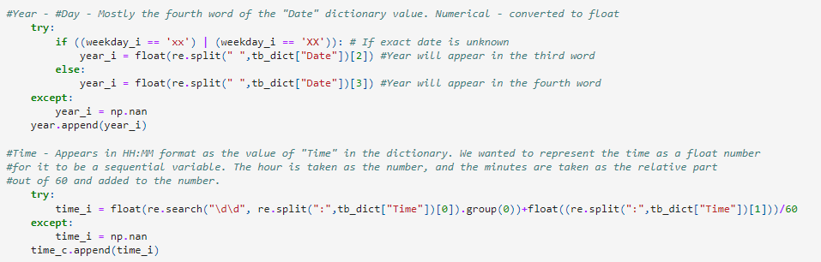
SUB-STEP 3.1 – ACCESSING THE TABLE
We then used the RegularExpression (re) library to analyze the text in each dictionary entry, and to find the value we need for our data frame columns. We used various methods, like splitting the text in a case of a repeating patterns (like date segments) and searching for numbers
A short example from our code for how we used information by text analysis:

Slide 12
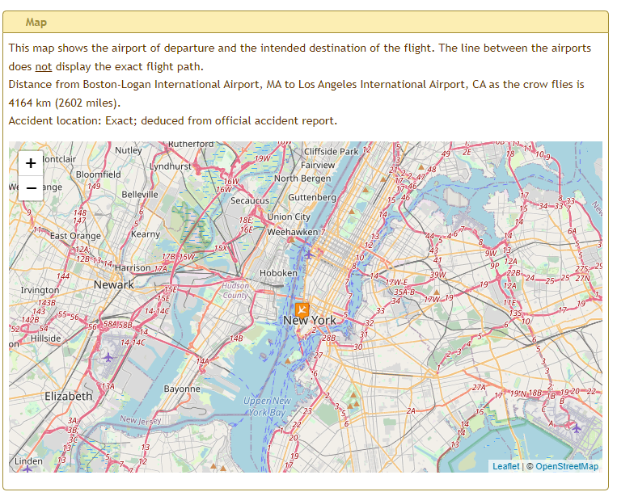
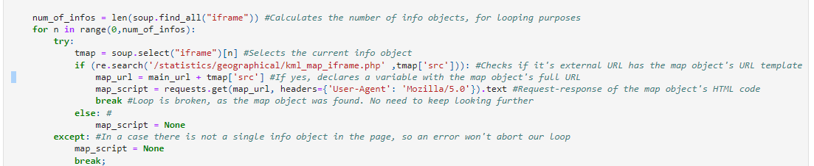
SUB-STEP 3.2 – EXTERNAL OBJECT
The map displayed in the page was an external web object, represented in an ‘iframe’ tag. We used the page’s HTML to find the tag that contains a URL to the map, and created another BeautifulSoup object which contained the script mentioning the accident coordinates. We again used the RegularExpressions library to locate the coordinates we needed for our data frame, which also have a repeating pattern regarding their appearance in the script:
A short example from our code about how we located the map object:

Slide 13
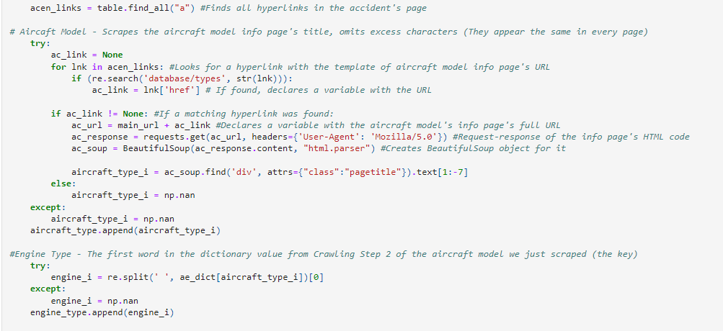
SUB-STEP 3 – BUILDING DATA FRAME
Last but not least, we used the files we created in the previous sub-steps for two purposes:
Reducing the number of unique aircraft model options, by accessing the link which leads to an info page with a general model name
Using the general model name to understand the engine type and number for the aircraft
A short example from our code for how we accessed the general model name, and used it to get the engine type:

Slide 14
OUR DATA FRAME
WEEKDAY
TIME
MONTH
DAY
YEAR
AIRCRAFT TYPE
The day of the week when the accident occurred
The month when the accident occurred
The hour and the minute on a the squence of 0-23.999
The day of the month when the accident occurred
The year when the accident occurred
The model and the company of the aircraft involved

Slide 15
OUR DATA FRAME
NO. OF ENGINES
ENGINE MODEL
CYCLES
ENGINE TYPE
YEARS ACTIVE
AIRFRAME HOURS
Of the aircraft involved
Number of flights the aircraft has had
Installed on the aircraft
Of the aircraft involved
Time since the aircraft’s first flight
The time the aircraft has spent airborne

Slide 16
OUR DATA FRAME
OPERATOR
LOCATION
FLIGHT PHASE
OCCUPANTS
ABOVE OCEAN?
DAMAGE
Airline/body which operated the aircraft
Where the accident has occurred
Phase of the flight in which the accident has occurred
Passengers and crew on-board the aircraft
Was the accident above ocean or not
Did and how bad was the damage the aircraft suffered from

Slide 17
OUR DATA FRAME
FATE
LONGTITUDE
LATITUDE
FATALITIES
What happened with the aircraft after the accident
Longitude coordinate of the accident
Latitude coordinate of the accident
How many fatalities were on-board following the accident

Slide 18
02
DATA HANDLING

Slide 19
DATA HANDLING
MISSING DATA
DUPLICATIVE DATA
STRING CONVERSION
Data Handling is an important step to get our data frame ready for modelling.
We had to handle our data from several angles:
To be handled by dropping rows/columns with missing cells, or to be filled by balancing values.
Since every scraped URL redirects to a different accident – there aren’t any duplicates in our data
We will convert every column represented by string values to numerical values

Slide 20
MISSING DATA
IMPORTANT?
CAN BE FILLED?
WHAT TO REMOVE
We approach every column with missing data by asking the following three questions:
01
02
Is the info the column provides important enough?
If yes, in which method?
03
Rows? The entire column?

Slide 21
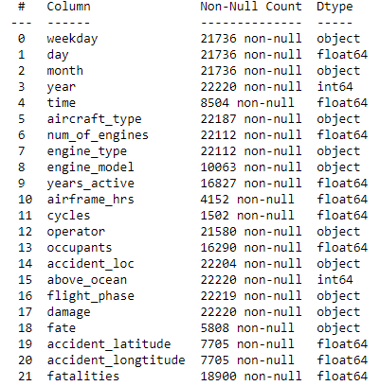
MISSING DATA
We used the .info() method to review our data and to decide which columns we must keep.
For that column we asked whether its missing value could be filled. If not, we deleted rows that missed data in them.
This process removed missing values for other columns as well,
We repeated the process: we found columns with substantial missing data for our ‘new’ data frame, and for those who couldn’t be filled up but
Were still important for us – we went and removed rows that missed values from these columns.
An example from our code:

Slide 22
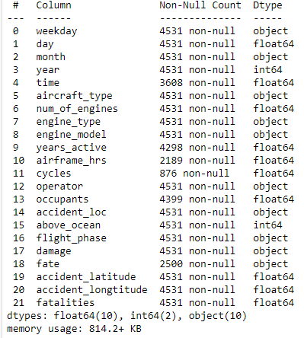
MISSING DATA
After removing rows, we reviewed which columns kept losing data and still miss too much data, so if they were to be filled – the data will
Become to biased. We decided to remove these columns: Two overall.
An example from our code:

Slide 23
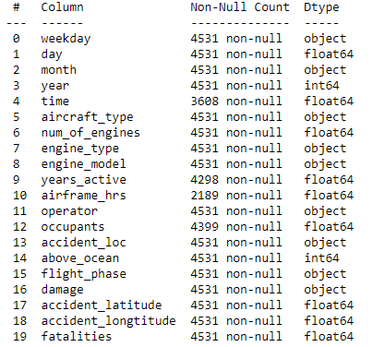

MISSING DATA
We remained with four columns with missing values, that: - Didn’t miss substantial amount of data. - Were important enough to keep. - Missing values in the column could be filled.
They were filled up in the following methods:
1) Time – Filled by the median value of the column
An example from our code:

Slide 24
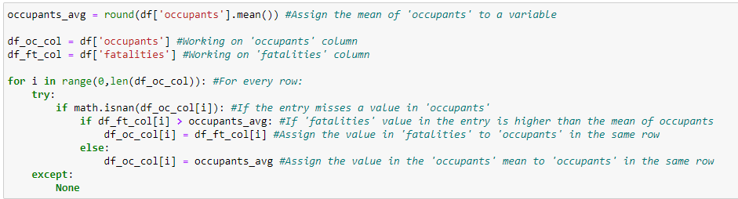
MISSING DATA
2) Occupants – The value in the Fatalities column cannot surpass the value in this column. As the Fatalities column now doesn’t have missing values, the following method was used to fill up missing values in the Occupants :
Calculate the mean of the Occupants column
If the value in Fatalities is less or equal to the mean – assign the value in Fatalities to Occupants of the same row.
If the value in Fatalities is more than the mean – assign the mean value to Occupants of the same row.
An example from our code:

Slide 25
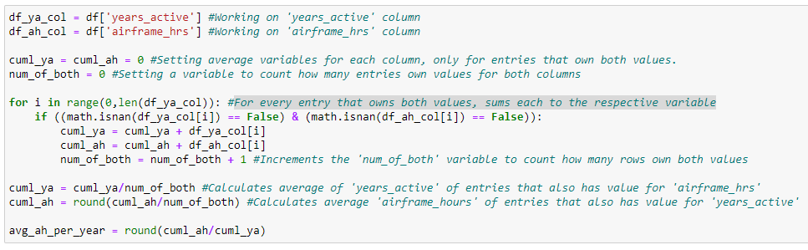
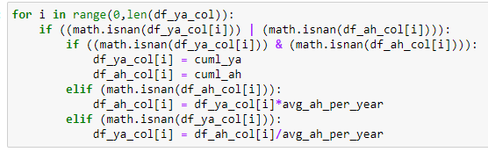
MISSING DATA
3-4) Airframe Hours and Years Active – We decided to be creative here.
As Airframe Hours can be calculated as a kind of a function of Years Active, we filled both columns up in the following method:
In every row that doesn’t miss a value in both columns, we summed each column’s values in a separate variable.
We assigned the result of their division in a third new variable, to represent the average airframe hours per year of activity.
For rows that missed values only for Years Active, we assigned the result of the value in Airframe Hours divided in the mean variable.
For rows that missed values only for Airframe Hours, we assigned the result of the value in Years Active multiplied with the mean variable.
An example from our code:

Slide 26
STRING CONVERSION
In order for being able to apply a machine learning model to our data, we need to convert
All the string values in the data to numerical values. Depending on how many unique values
There are in a column, there are two ways to convert strings to numerical values:
01
DEFINITIVE
REPLACING
02
GENERAL
REPLACING
For small numbers of unique possible values
For large numbers of unique possible values

Slide 27
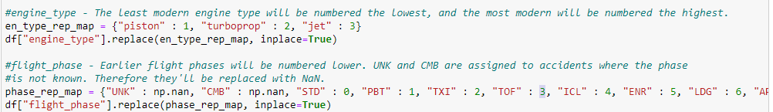
STRING CONVERSION
DEFINITIVE REPLACING
We use it for columns that have a small number of unique possible values.
In such a case, we can determine which numerical number each possible value will be replaced with.
An example from our code:

Slide 28
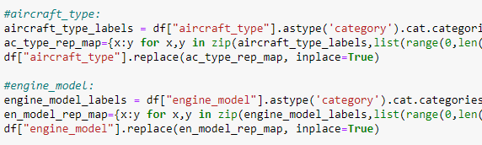
STRING CONVERSION
GENERAL REPLACING
We use it for columns that have a large number of unique possible values.
In such a case, we run a general loop that allocates a number to every value on its own
An example from our code:

Slide 29
89,620
Number of cells in the data frame after cleaning

Slide 30
03
VISUAL DATA ANALYSIS

Slide 31
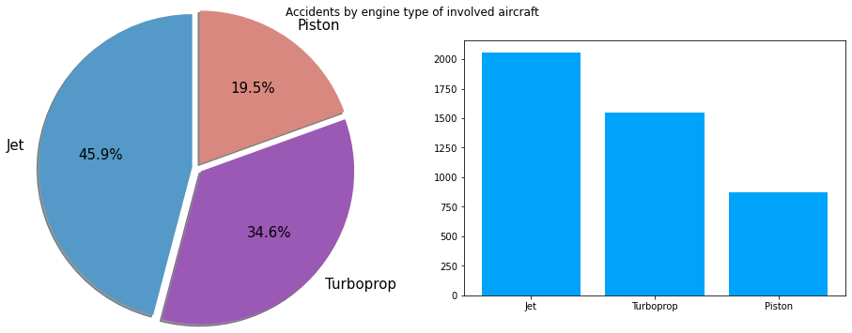
BAR AND PIE CHARTS

Slide 32
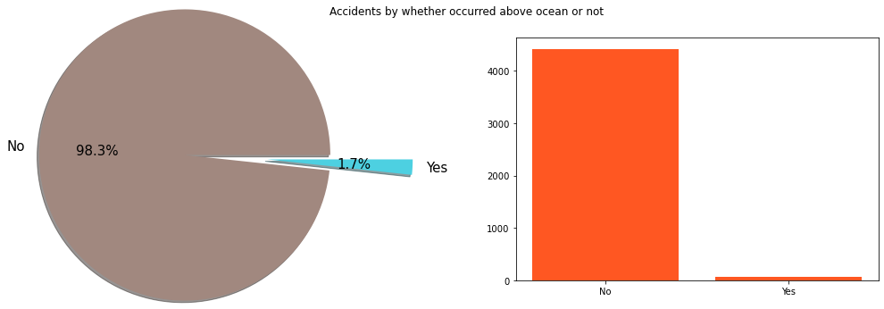
BAR AND PIE CHARTS

Slide 33
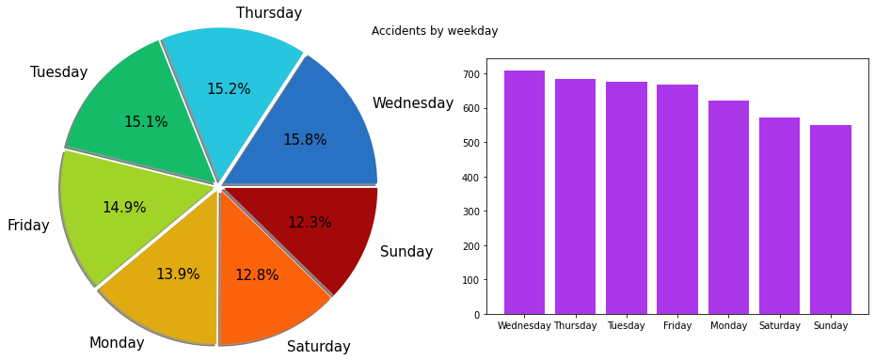
BAR AND PIE CHARTS

Slide 34
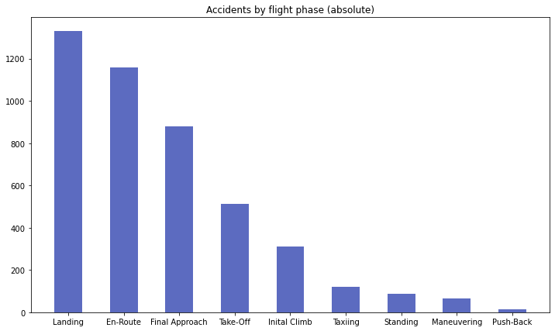
BAR AND PIE CHARTS

Slide 35
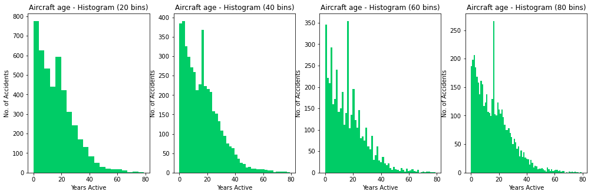
BAR AND PIE CHARTS

Slide 36
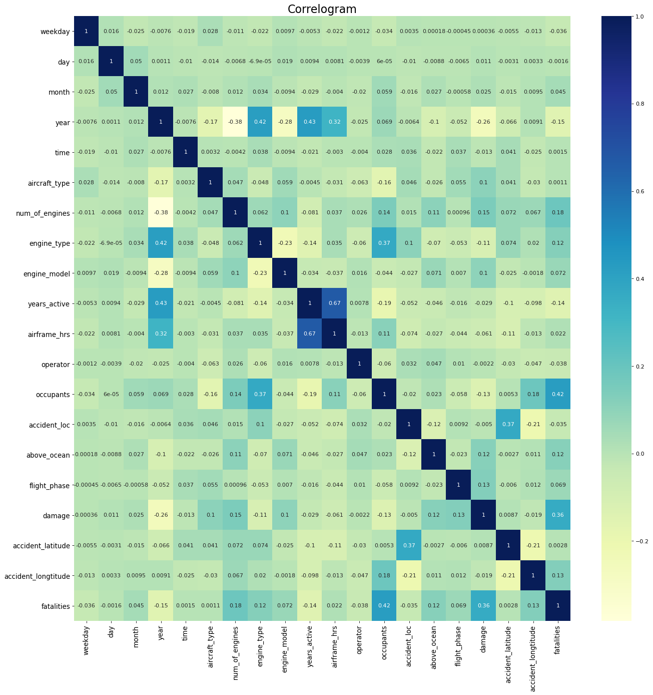
CORRELOGRAM

Slide 37
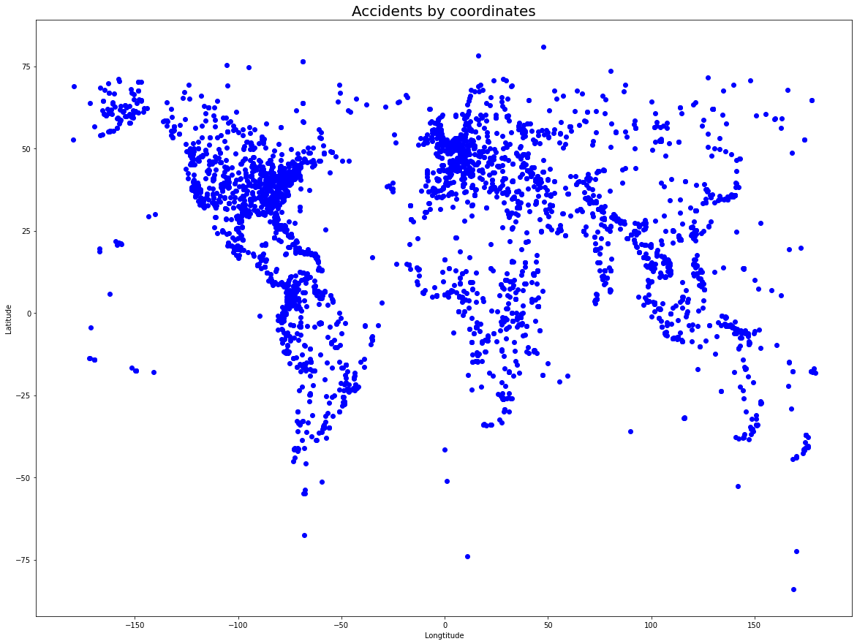
SCATTER PLOTS

Slide 38
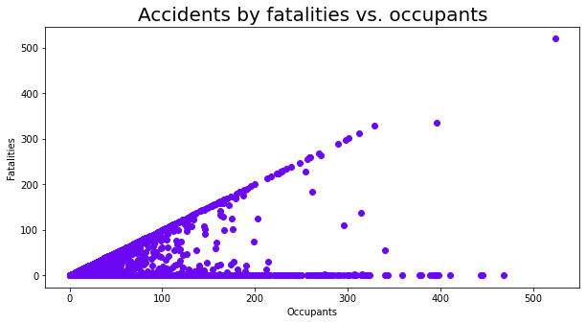
SCATTER PLOTS

Slide 39
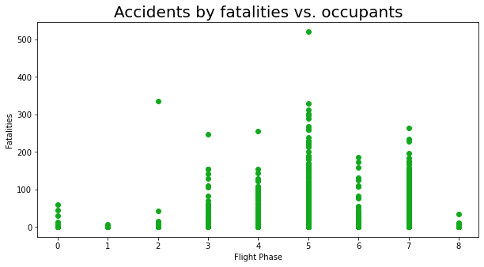
SCATTER PLOTS

Slide 40
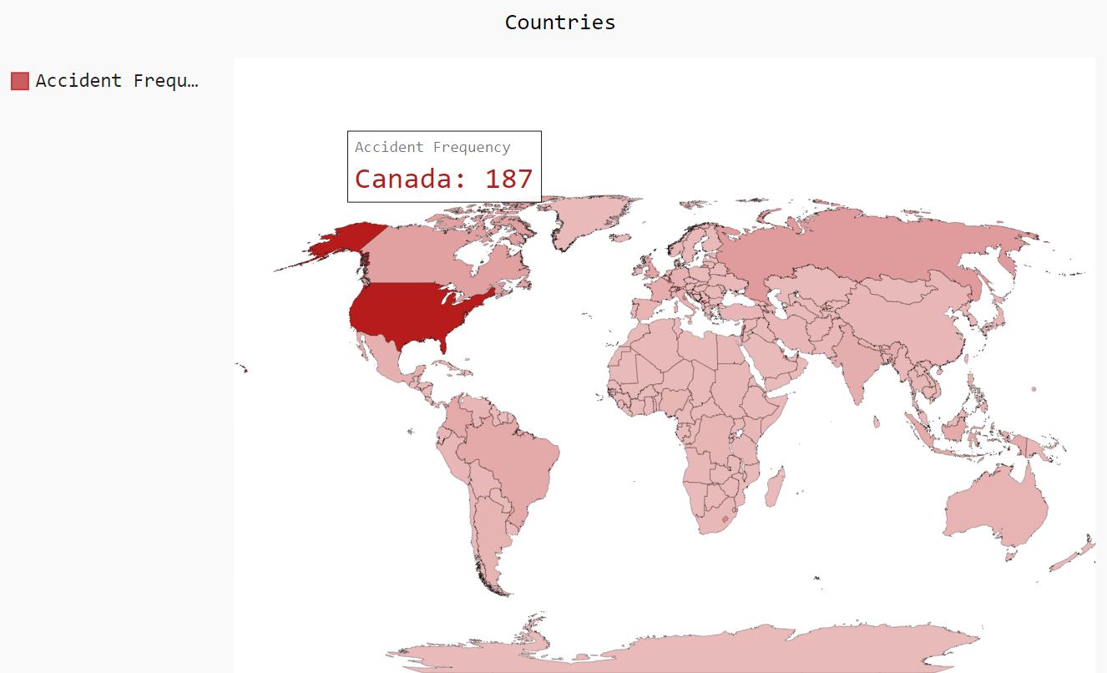
WORLD MAP VISUAL
We used the pygal library to render a world map, using data from our data frame.

Slide 41
04
MACHINE
LEARNING

Slide 42

MACHINE LEARNING
Let’s remember our question: Can we predict the number of fatalities in an aircraft accident by several factors about the flight, accident location and all the other data frame’s parameters?
Since the Fatalities column is a numerical-sequential variable, we used the supervised learning model of Linear Regression. We aimed to calculate the $R^{2}$ and MSE scores, to evaluate the model’s precision.

Slide 43

MACHINE LEARNING
First Step: Separate our target column and the rest of our data frame
An example of our code:

Slide 44

MACHINE LEARNING
Second Step: Split the data frame to a train set and test set and train several models (Linear Regression, Lasso, Elastic Net, Ridge), on the splitted data frame
An example of our code:

Slide 45
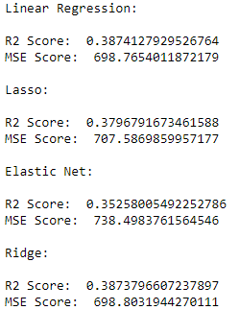

MACHINE LEARNING
Third Step: We applied the four models and we received the following initial $R^{2}$ scores and MSE scores, which we wanted to improve:

Slide 46
MACHINE LEARNING
Fourth Step: We tried to improve our predictions. We used feature engineering methods,
We found columns that had high correlations and potentially could have correlations with the target column, and applied arithmetic operations to their values to create value for the new column.
We also removed one categorical column (Operator) that had many unique values.

Slide 47
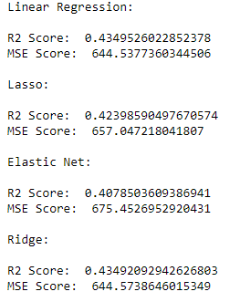
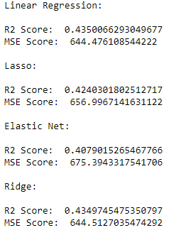
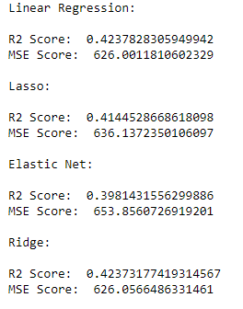
MACHINE LEARNING
We repeated the process separating, splitting and training the prediction models every time we applied feature engineering methods, we received the following results before scores reached convergence:

Slide 48
CONCLUSION

Slide 49

CONCLUSION
After all improvement attempts, the maximum scores we accepted were:
$R^{2}$ score: 0.435
MSE score: 644.476
Therefore, the model succeeded predicting ~43% of the accident’s fatalities
-----
Doing this project was very educating, it taught us how to look at data in
a different way than the way we were used to.

Slide 50
DATA SOURCES
The data we have used for the purpose of making this project is originated at:
AviationSafetyNetwork – hyperlink The entire data frame values were scraped from this website.
Wikipedia - hyperlink As a source to match country codes with country names for the world map visualization.
SlidesGo – hyperlink For the slidehsow template, design and inspiration. (Credited in the end of the slideshow as well).

Slide 51
THANK YOU FOR LISTENING

